Slide 1
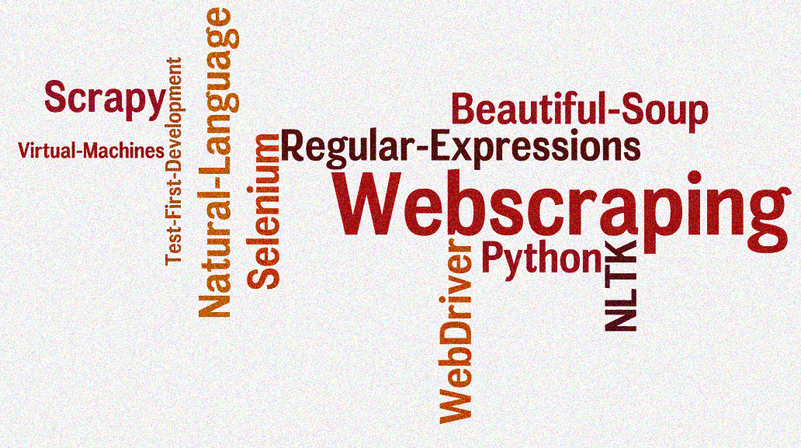
INFT6201 Big Data week-11 Presentation on “Web Scraping”
Presented by: Mohammed Rizwan Shakir Khan (c3363452)
Image retrieved from CSCE 590

Slide 2
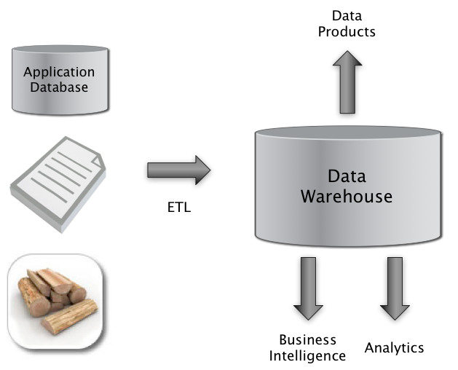
Data Analytics Concept
Web scraping is the practice of gathering data through any means other than a program interacting with an API (or, obviously, through a human using a web browser). This is most commonly accomplished by writing an automated program that queries a web server, requests data (usually in the form of the HTML and other files that comprise web pages), and then parses that data to extract needed information. (Mitchell, 2015)
(Brody, 2017)

Slide 3
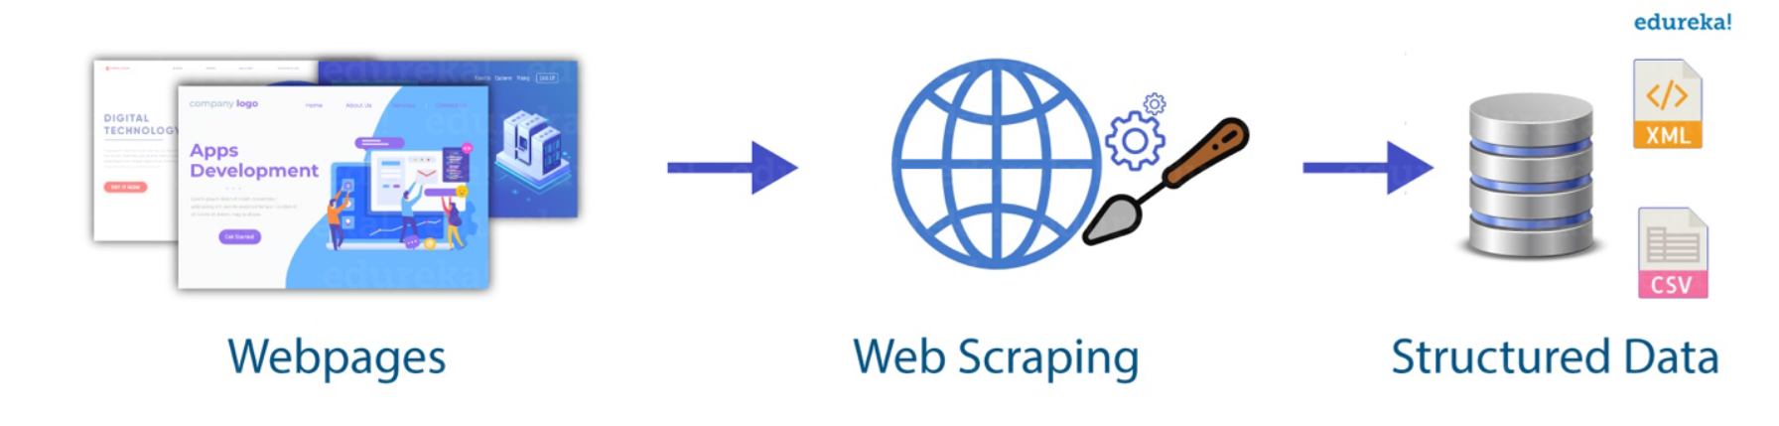
Data Analytics Concept Continued
Why Web scraping? If the only way you access the Internet is through a browser, you’re missing out on a huge range of possibilities. (Mitchell, 2015)
(Huang, 2018)

Slide 4
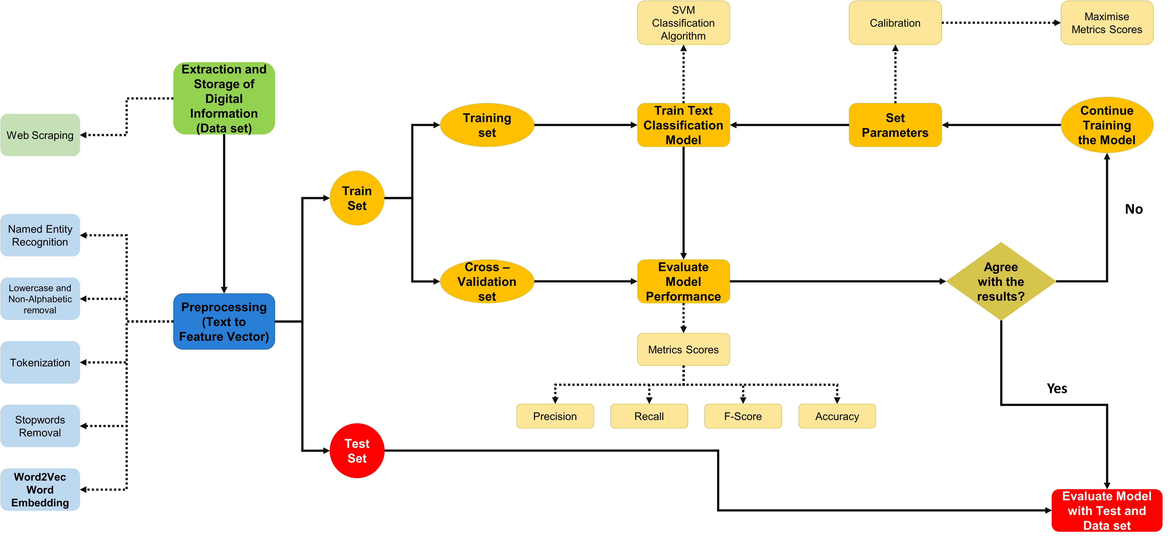
Data Analytics Concept Continued (Tip of the Iceberg)
(Corzo, 2019)

Slide 5
Ethical Side of Web scraping
Gray Area (Fine line between legal and illegal {undefined and ambiguous})
Respect “Robots.txt” on websites
Overseas Jurisdiction ( Conflict within States of USA)
Limit REQUESTS per attempt
Do not slow down websites by increasing the traffic flow.

Slide 6
Case Study - 1
One of the Python advantages is a large selection of libraries for web scraping. Notably, there are several types of Python web scraping libraries from which you can choose:
Requests: This is Python’s best HTTP request library. You will be using it to fetch web pages using get/post/etc requests.
Beautiful Soup: Beautiful Soup is a Python library that works with a parser to extract data from HTML and can turn even invalid markup into a parse tree. However, this library is only designed for parsing and cannot request data from web servers in the form of HTML documents/files.
Lxml: is ideal when extracting data from large dataset
Selenium: some websites are written using JavaScript, a language that allows developers to populate fields and menus dynamically. This creates a problem for Python libraries that can only extract data from static web pages. In fact, as stated, the Requests library is not an option when it comes to JavaScript. This is where Selenium web scraping comes in and thrives.
Scrapy: Scrapy is a fast high-level web crawling and web scraping framework, used to crawl websites and extract structured data from their pages.

Slide 7
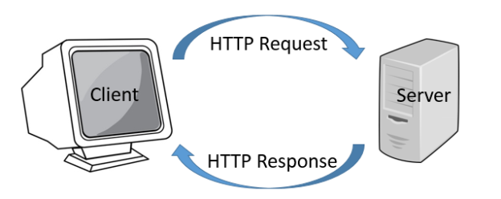
Case Study Continued
Retrieved from Hyland
To extract data using web scraping with python, you need to follow these basic steps:
Find the URL that you want to scrape
Inspecting the Page
Find the data you want to extract
Write the code
Run the code and extract the data
Store the data in the required format

Slide 8
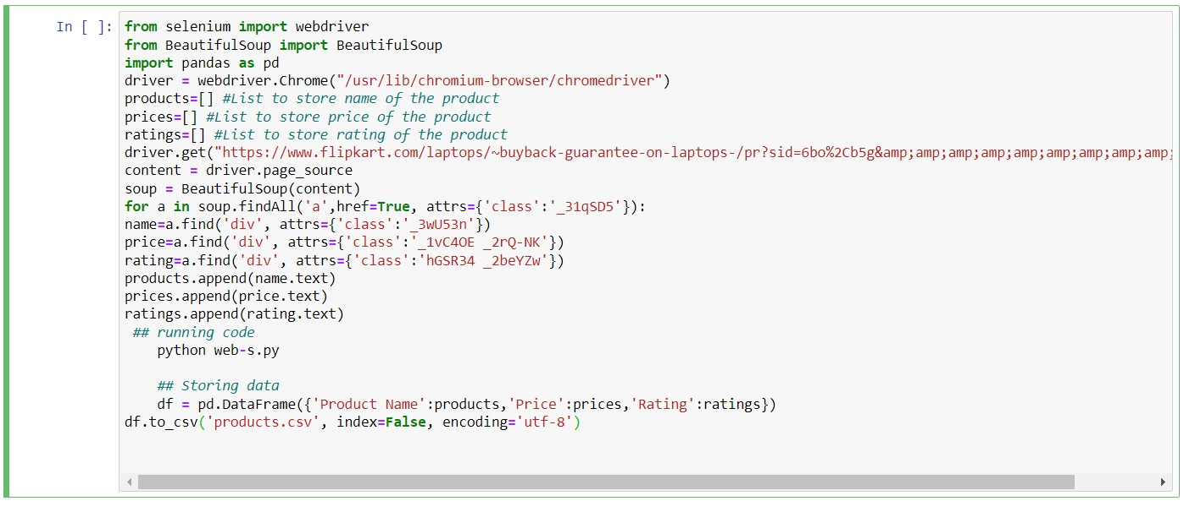
Case Study Continued
https://www.flipkart.com/laptops/~buyback-guarantee-on-laptops-/pr?sid=6bo%2Cb5g&uniqBStoreParam1=val1&wid=11.productCard.PMU_V2
.

Slide 9
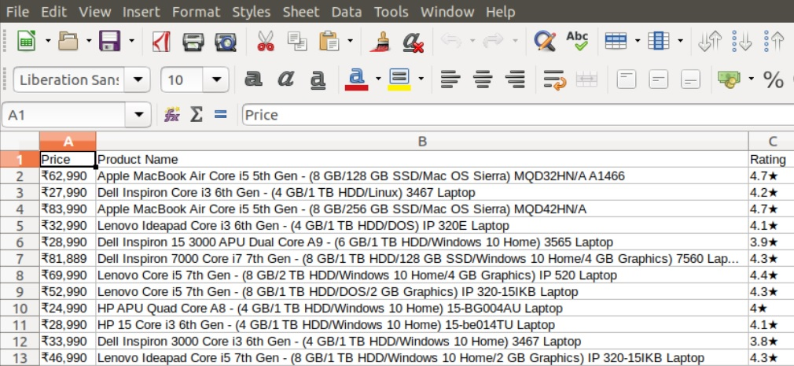
Case Study Continued

Slide 10

Case Study – 2 ( using scrapy)
spiders folder: This folder contains all of our future Scrapy spider files that extract the data.
items: This file contains item objects that behave like Python dictionaries and provide an abstraction layer to store scraped data within the Scrapy framework.
middlewares (advanced): Scrapy middlewares are useful if you want to modify how Scrapy runs and makes requests to the server (e.g., to get around antibot solutions). For simple scraping projects, you don’t need to modify middlewares.
pipelines: Scrapy pipelines are for extra data processing steps you want to implement after you extract data. You can clean, organize, or even drop data in these pipelines.
settings: General settings for how Scrapy runs, for example, delays between requests, caching, file download settings, etc.
Retrieved from Hyland

Slide 11
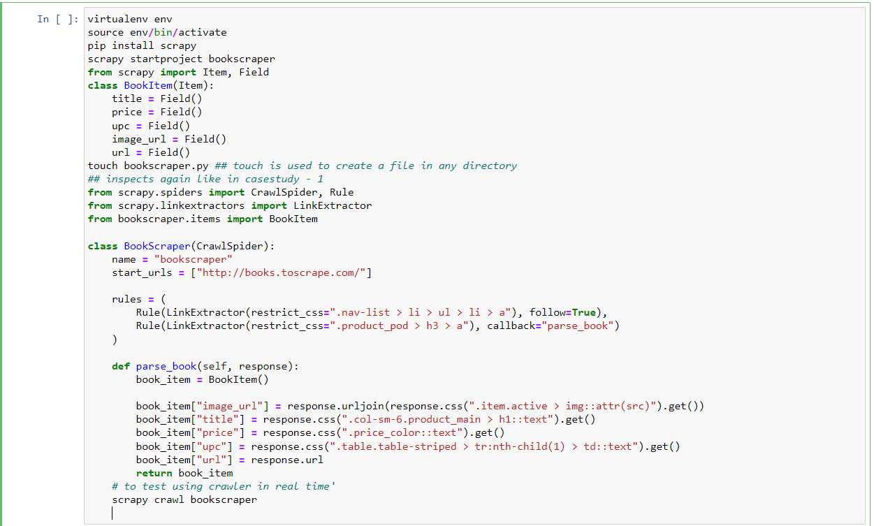

Slide 12
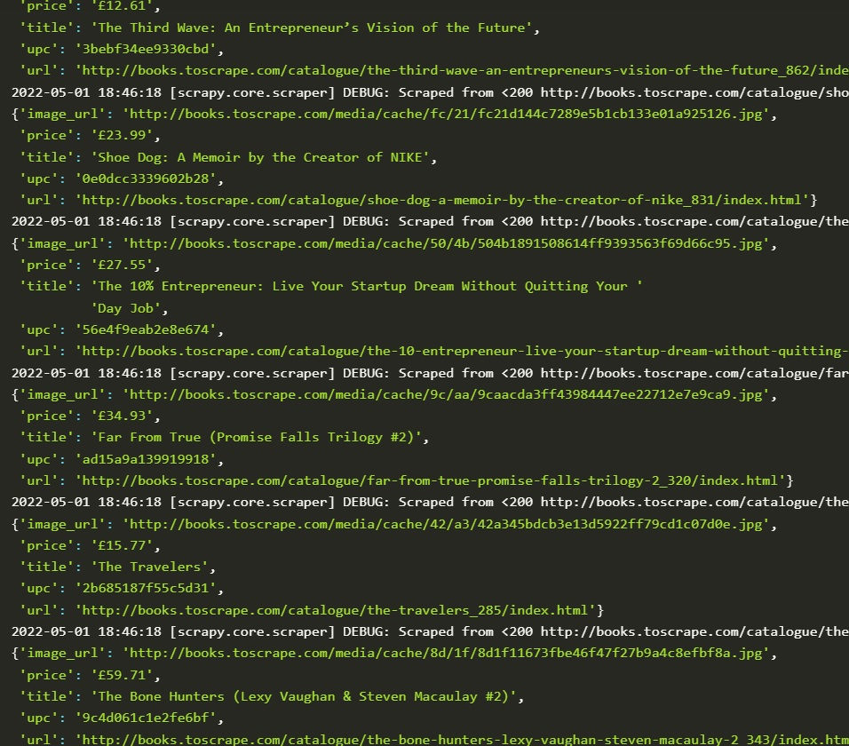
Crawler
Real-time test:

Slide 13
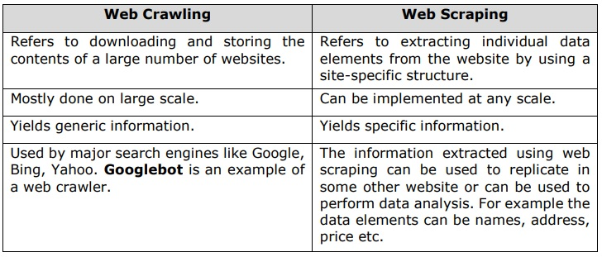
Applications in practice
Google Lens
Google Scholar
Google Images
Google Advanced Search
Web Crawler vs Web Scraper !
Retrieved from tutorialspoint.com

Slide 14
Applications in practice Continued
Searching for Real Estate or Hotel Listings
MakeMyTrip.com, Goibibbo.
Analyzing the Stock Market
Content Marketing
Collecting Training Data for Machine Learning
Search Engine Optimization (SEO)
Finding the Cheapest Online Retail Deals (Ecommerce market)
Amazon, Ebay

Slide 15
Technical Overview (NEWS and Rating Agencies)
RSS Feeds
News Websites
Newsletters
Real Time
Sources gathered “on the fly”
Multiple input formats
Manages RSS feeds, news websites, online newsletters
Handles password-protected sites
Automatic login
Uses “lightweight” code
Adaptable script language (Python)
Copyright compliant
Only scraping/extracting content that is free or globally licensed by BI
Web crawling agent (
Parse news items & components
Filter
Relevancy &
Minimum date
Standardized display for selection
Manual selection / curation
Output presentation (HTML)

Slide 16
References
Agius, A. (2016). Considering Legal Perspectives and an Australian Approach to Data Scraping. Considering Legal Perspectives and an Australian Approach To Scraping Data From The Modern Web. Retrieved date 1-11-2022.
Brody, H. (2017). The Ultimate Guide to Web Scraping. Leanpub. Retrieved date 1-11-2022.
Corzo, G. (2019). Natural Language Processing In Integrated Water Resources Management. Case Study: Three Bolivian River Basins., 1 and 2. Retrieved date 1-11-2022.
Huang, J. (2018). Using Data Analytics to Develop a Web Resource to Access Trends in Information Technology Careers. USA: Pace University. Retrieved date 1-11-2022.
Mitchell, R. (2015). O’Reilly Web Scraping with Python. Sebastopol,: O’Reilly Media. Retrieved date 1-11-2022.

